Slide 1


Slide 2
AI Lab 01
Lab introduction, and Python basics

Slide 3
Outline
Course plan
Required software
Python basics

Slide 4
Course Plan

Slide 5
Course Plan (Lab)
Week | Topic
1 | Python basics + numpy pandas matplotlib
2 | Pre-Processing
3 | k-nearest neighbors (KNN)
4 | K-means
5 | Naïve Bayes
6 | Decision Tree (DT)
7 | Random Forest (RF)
8 | Linear-Regression
9 | Logistic Regression
10 | Support Vector Machine (SVM)

Slide 6
Required software

Slide 7
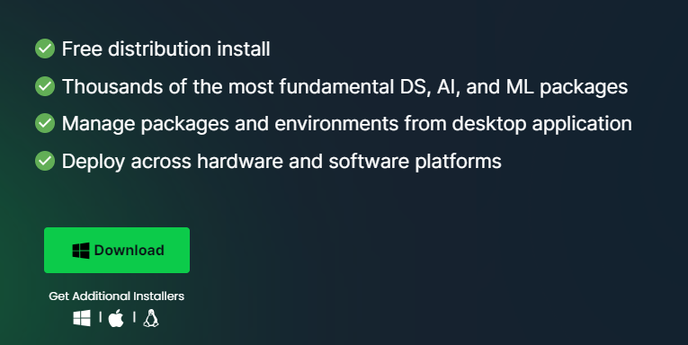
Anaconda
Download from here: https://www.anaconda.com/download

Slide 8
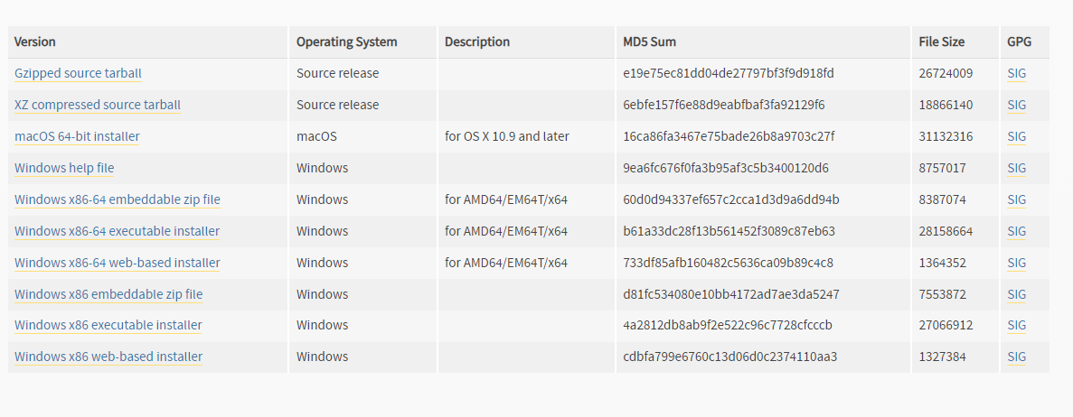
Python
Download from here: https://www.python.org/downloads/release/python-390/

Slide 9
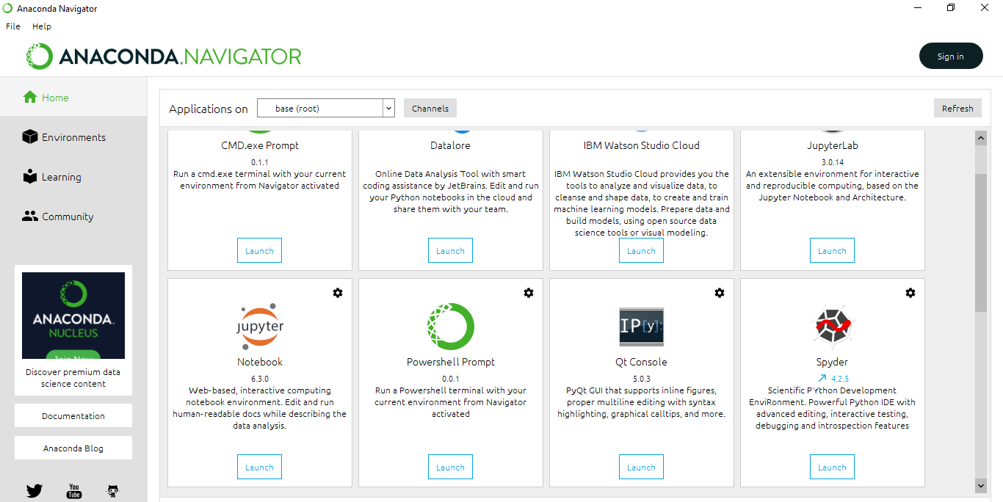
Anaconda Distribution
We use Jupyter Notebook

Slide 10
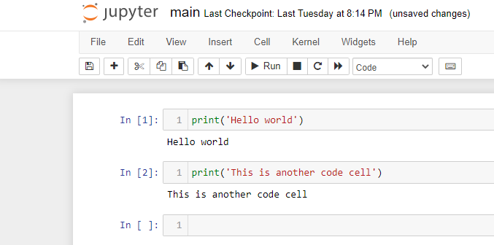
Jupyter Notebook

Slide 11
Python basics

Slide 12
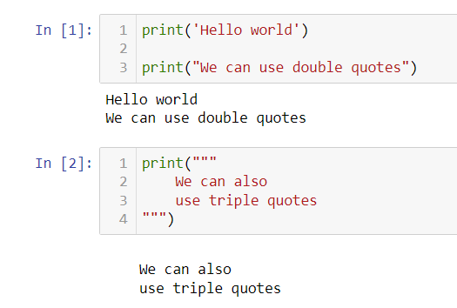
Printing output

Slide 13
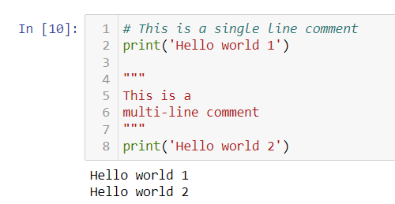
Comments

Slide 14
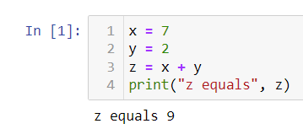
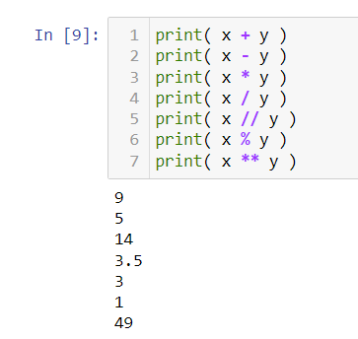
Variables, arithmetic operators

Slide 15
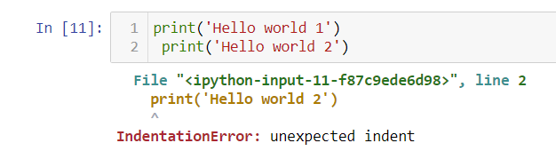
Spaces are important in Python

Slide 16
Error message
Read from bottom to top

Slide 17
Error message
Error reason (this means our spaces are wrong)

Slide 18
Error message
line

Slide 19
Error message
here it is

Slide 20
Error message
Filename (this means our cell)

Slide 21
Error message
Line number

Slide 22
Error message
If this is not your code (like when you import a library), continue reading from bottom to top

Slide 23
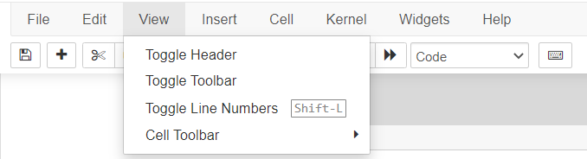
Line numbers
You can show line numbers if they are hidden

Slide 24
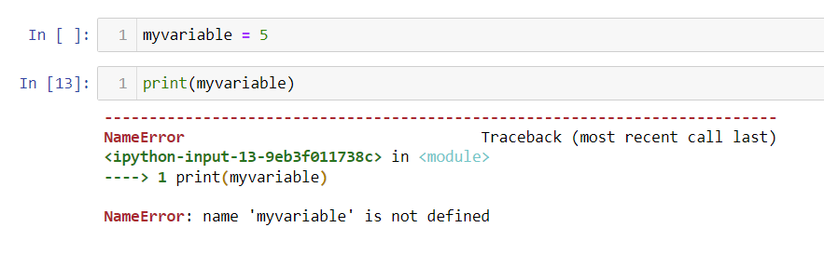
Order of running cells is important

Slide 25
Order of running cells is important
This means either we forgot to run the previous cell or the variable name is wrong (or the variable is not defined at all)

Slide 26
Order of running cells is important
We must run this first

Slide 27
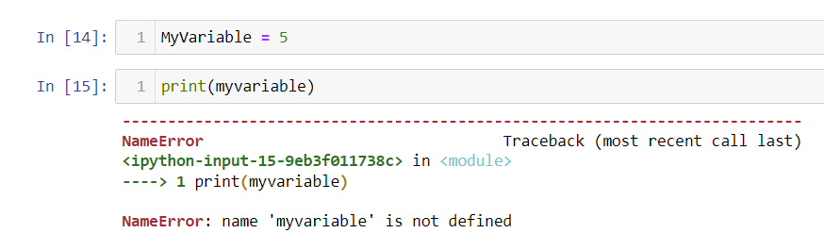
Variables are case-sensitive

Slide 28
Variables are case-sensitive
Again, this means either we forgot to run the previous cell or the variable name is wrong (or the variable is not defined at all)

Slide 29
Variables are case-sensitive
The names are different

Slide 30
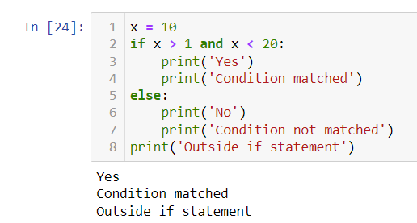
If statement

Slide 31
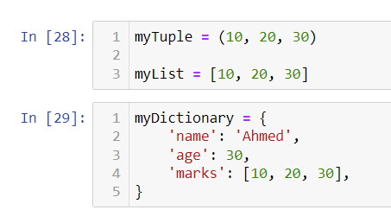
Data structures

Slide 32
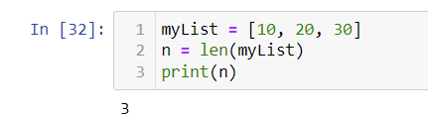
Length of a list (or a tuple)

Slide 33
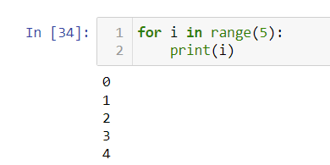
For loop

Slide 34
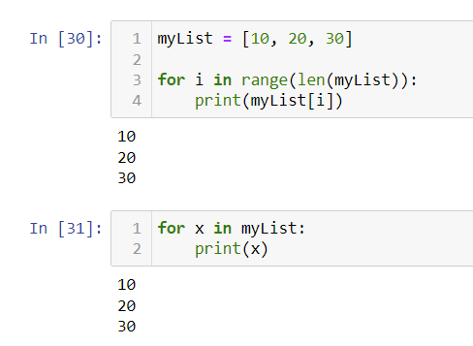
For loop

Slide 35
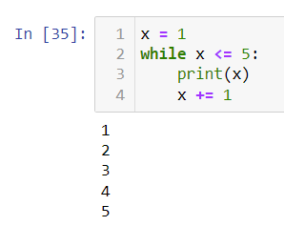
While loop

Slide 36
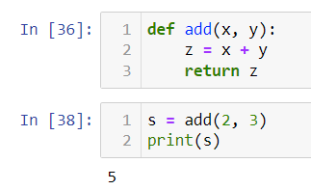
Functions

Slide 37
Numpy

Slide 38
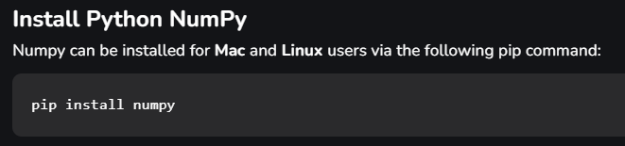
Install

Slide 39
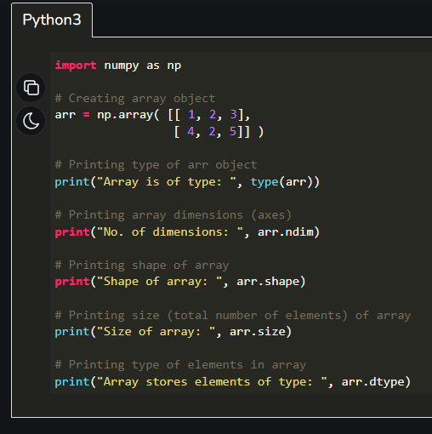
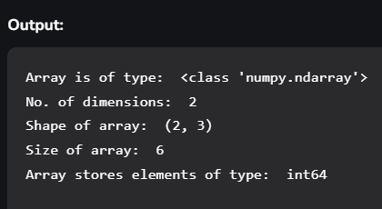
numpy

Slide 40
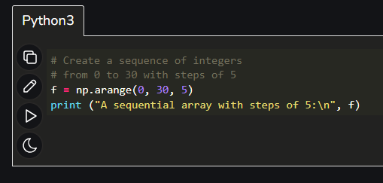
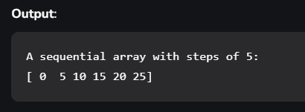
numpy

Slide 41
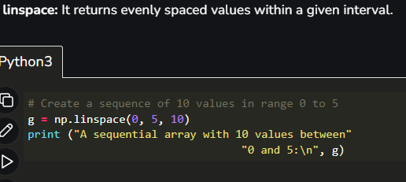
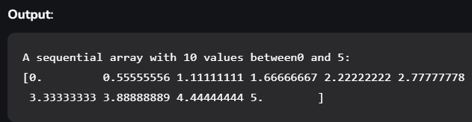
numpy

Slide 42
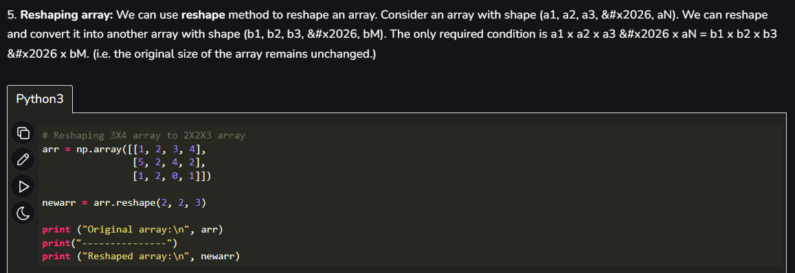
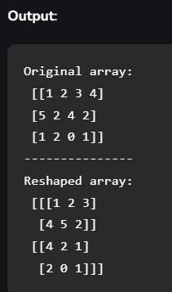
numpy

Slide 43
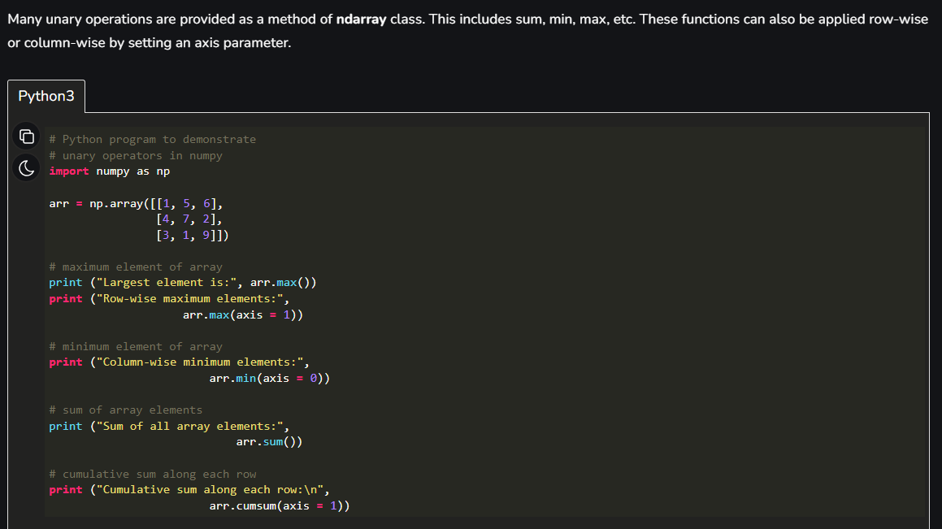
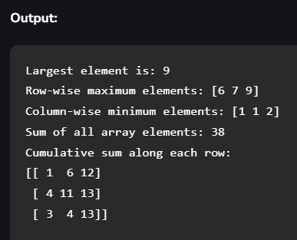
numpy

Slide 44
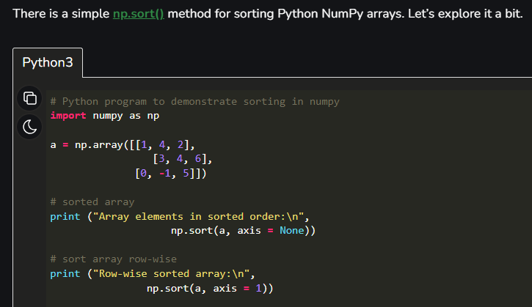
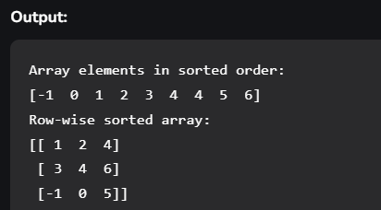
numpy

